Slide 1









Idea submission

Slide 2


Team details
Team Lead: Name: Elvis Bibu
Contact:9481807810
Email:elvisbibu.ad23@bmsce.ac.in
Team Member 2: Name: Kirthan A
Contact:8073762862
Email:kirthana.ad23@bmsce.ac.in

Slide 3


Our solution
This Project aims to maximize the Deep focus of person by studying their behavioral patterns and optimizing the conditions

Slide 4

TECHNICAL APPROACH
Chatbot- A chatbot that is trained with a dataset regarding behavioral patterns
React-Used to Make the frontend of the website
Flask-Integrate the chatbot onto the frontend

Slide 5
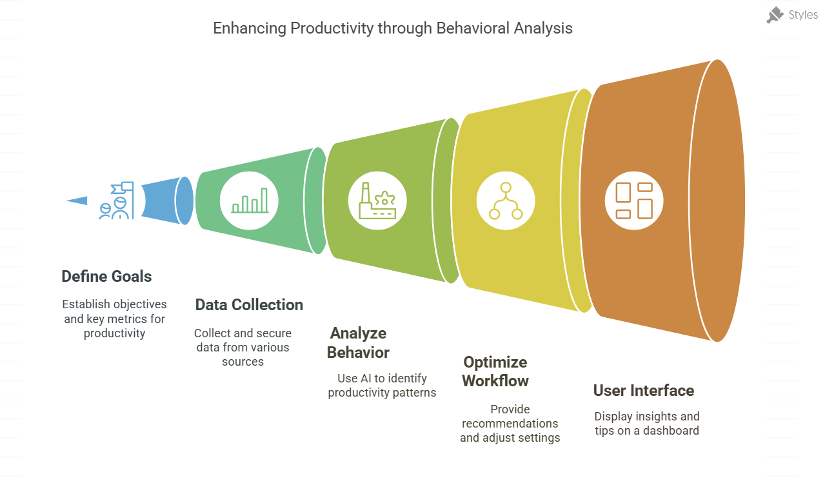
Workflow/pipeline

Slide 6
Feasibility & FUTURE SCOPE
Pros- Personalized AI that adapts to individual work habit
Cons-Users might hesitate to enter such sensitive data
Future Scope-Self reflection chatbot that’s asks question back and can compare past data to the new data

